Slide 1
FlipTab from Team Norse
Identifying the market opportunity / Low-fidelity Prototype due / testing your value proposition with customers

Slide 2
Summary
Low-Fidelity Prototype
Customer Feedback

Slide 3
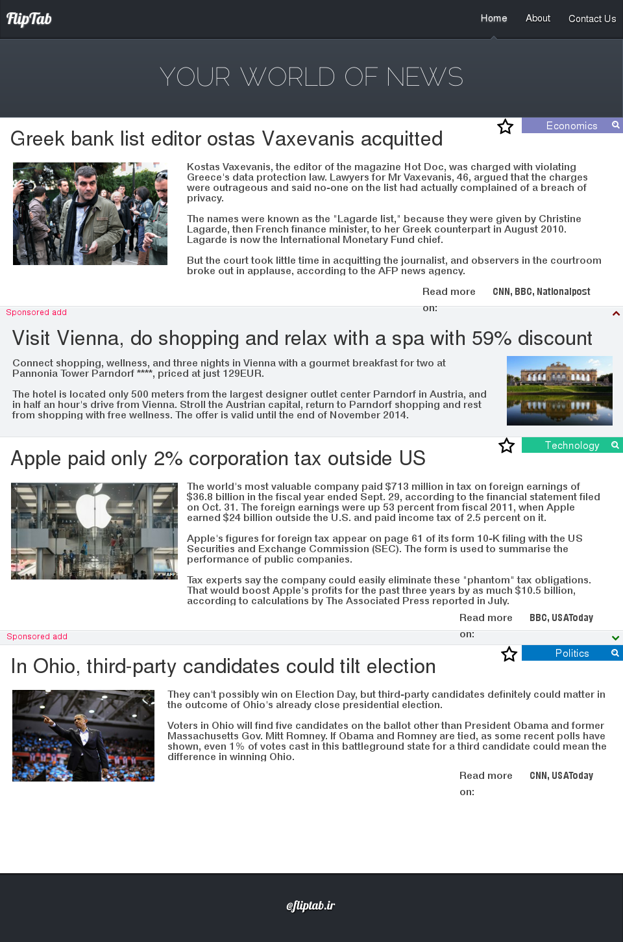
Low- Fidelity Prototype
Information Architecture
http://flattab.weebly.com/
Mock-up

Slide 4
Customer Feedback
Designer → Design Issues
Introduce horizontal scrolling on article
Will allow us to display more articles in a topic, e.g. Politics
Liked the idea of article styled context sensitive ads
Developer → Algorithms
Which algorithms to:
Decide which summary comes first
Rank articles while summarizing and displaying links
Manager → Commercial / Legal
Commercial: How to define ads? How to sell? Pricing?
Legal: Will NLP impact content owners’ copyright?
Can we summarize content based on keywords?

